Slide 1


WELCOME TO
ATEN ENGLISH
CLASS: COM1.11
INSTRUCTOR: HAO NGUYEN
DATE:

Slide 2
JOBS AND CAREER
Lesson 4

Slide 3
TABLE OF CONTENTS
01
03
02
04
Vocabulary
Grammar
Jobs
Be going to
Speaking
Listening
Jobs and career
Part time jobs

Slide 4
01
Vocabulary
Jobs

Slide 5
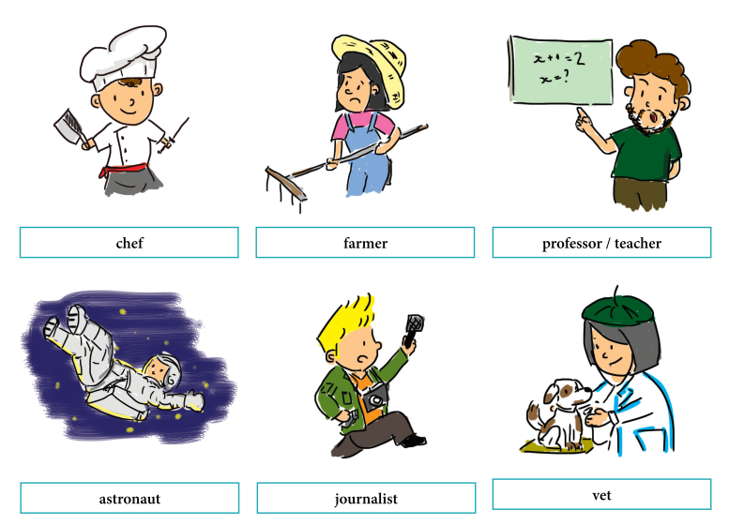

Slide 6
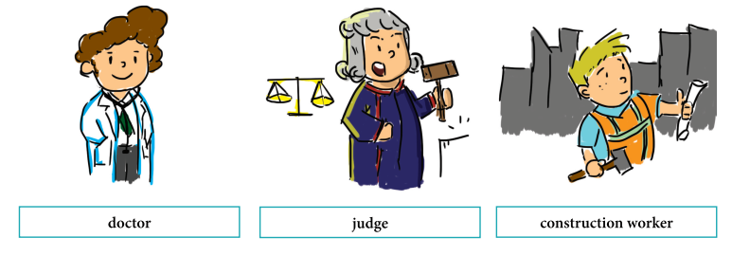
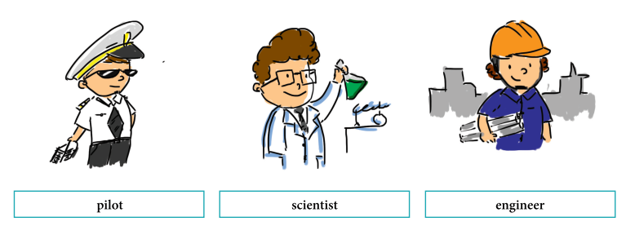

Slide 7
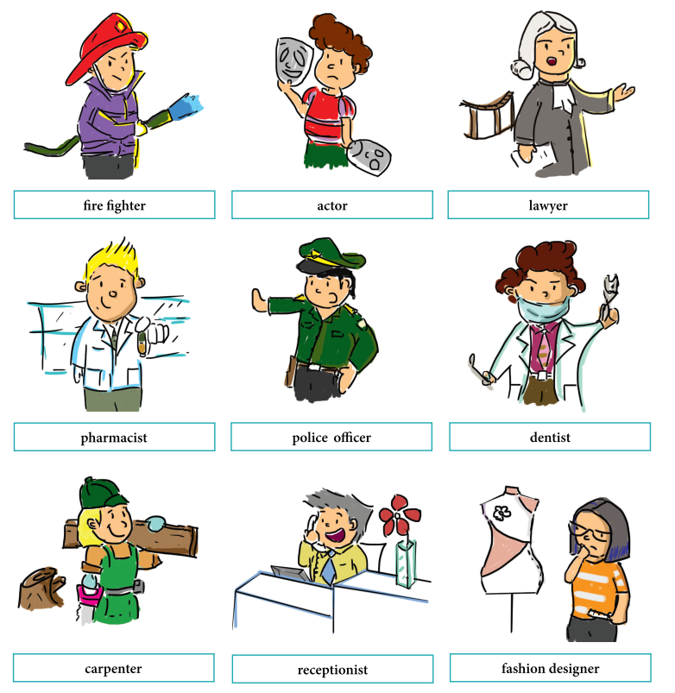

Slide 8
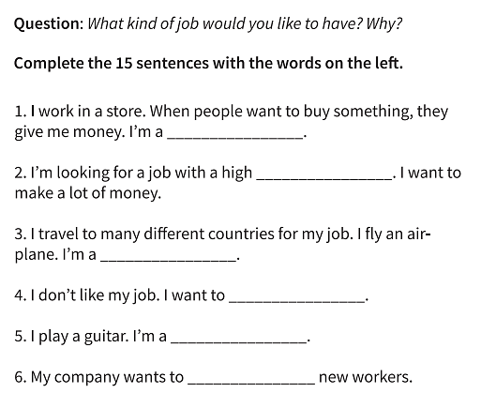
cashier
salary
pilot
quit
musician
hire

Slide 9
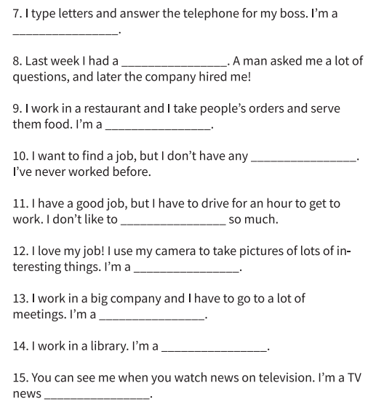
secretary
job interview
Waiter/ waitress
work experience
commute
photographer
manager
librarian
reporter

Slide 10

02
SPEAKING

Slide 11
WHAT DO YOU DO FOR A LIVING?
I work as an engineer
I stay at home and look after my children
I’m a teacher
I work with children with disabilities
I live by working as a nurse
I work with computers

Slide 12
WHO DO YOU WORK FOR?
I work for ABC agency
I have my own business

Slide 13
WHAT’S YOUR WORKING STATUS AT THE MOMENT?
I have a part time/ full time job
I’m unemployed
Im looking for a job

Slide 14
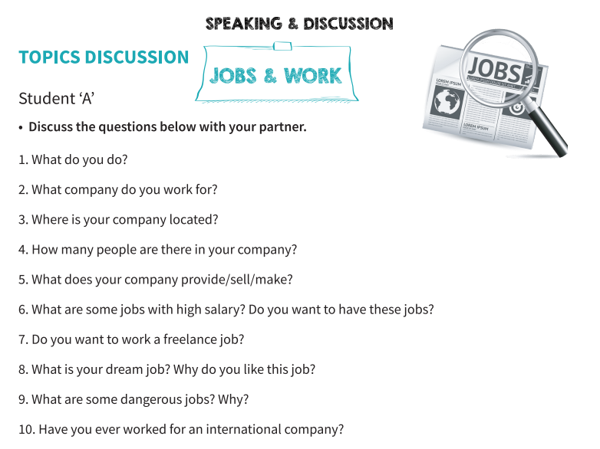
COPY
PROGRAMMING
Mercury is the closest planet to the Sun
Jupiter is the biggest planet of them all
PHOTOGRAPHY
BRANDING
It’s composed mostly of hydrogen and helium
Despite being red,
Mars is a cold place

Slide 15
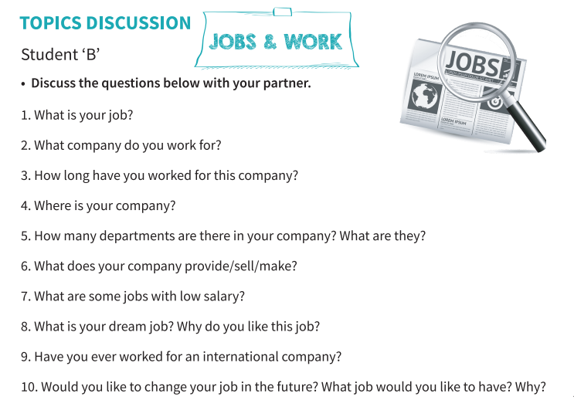
COPY
PROGRAMMING
Mercury is the closest planet to the Sun
Jupiter is the biggest planet of them all
PHOTOGRAPHY
BRANDING
It’s composed mostly of hydrogen and helium
Despite being red,
Mars is a cold place

Slide 16
03
GRAMMAR
Near future –
be going to

Slide 17
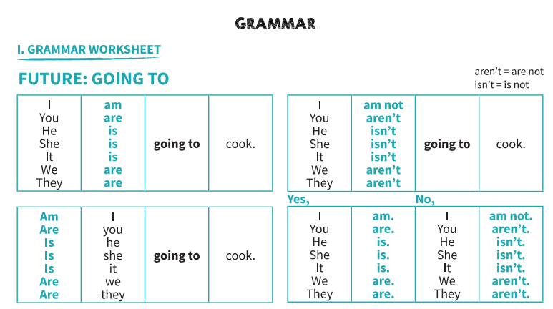

Slide 18
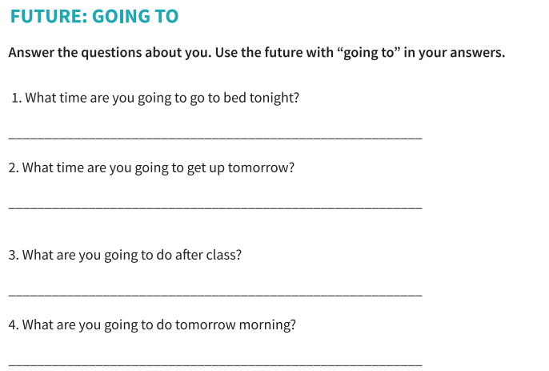

Slide 19
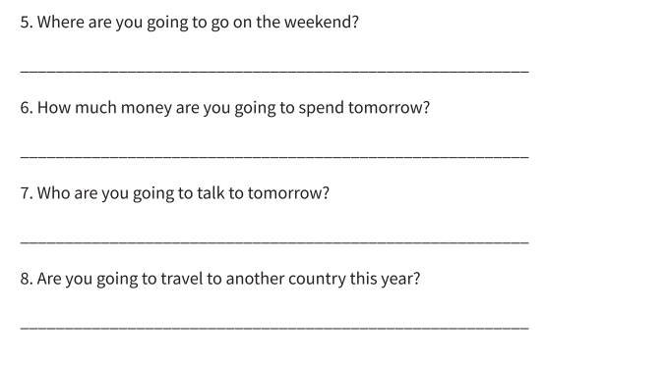

Slide 20

04
LISTENING
Part time jobs

Slide 21
